Slide 1
…who am I?
Amna Muneer 24345

Slide 2

My name
The name, Amna, is of Arabic origin and has multiple meaning.
In Arabic it means safe, caring and honest. In Urdu it can mean “at a higher statusرتبہ والی” and in English it means peace.

Slide 3
The Basics
Date of birth: 10th April 2003
Age: 18 years
Place of Birth: Karachi, Pakistan
Current education Institute: IBA (Institute of Business Administration)
Contact: email

Slide 4
Education
The journey of my education started at the age of 3 as I started Montessori from Brooks Grammar school and stayed there till Kindergarten II.
I went to PECHS Girls’ School for my education from first grade and continued studying there for 10 years i.e. 1st till 10th grade. I started studying there in 2009 and graduated in 2019
For my high school, I attended Aga Khan Higher Secondary School from 2019 till 2020.
Currently, I am studying at IBA (Institute of Business Administration) and am part of the batch 2025.

Slide 5
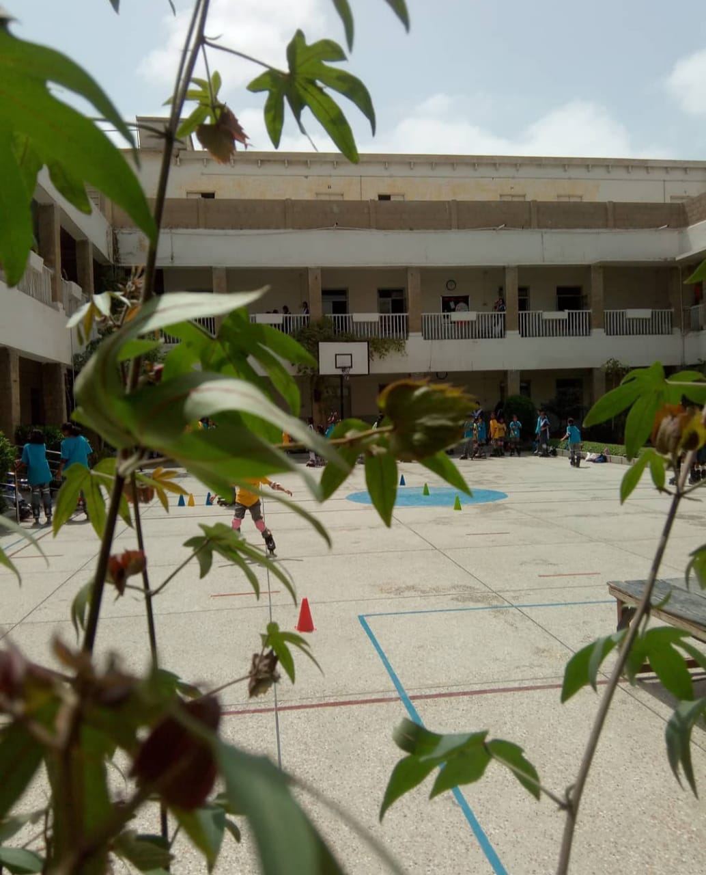
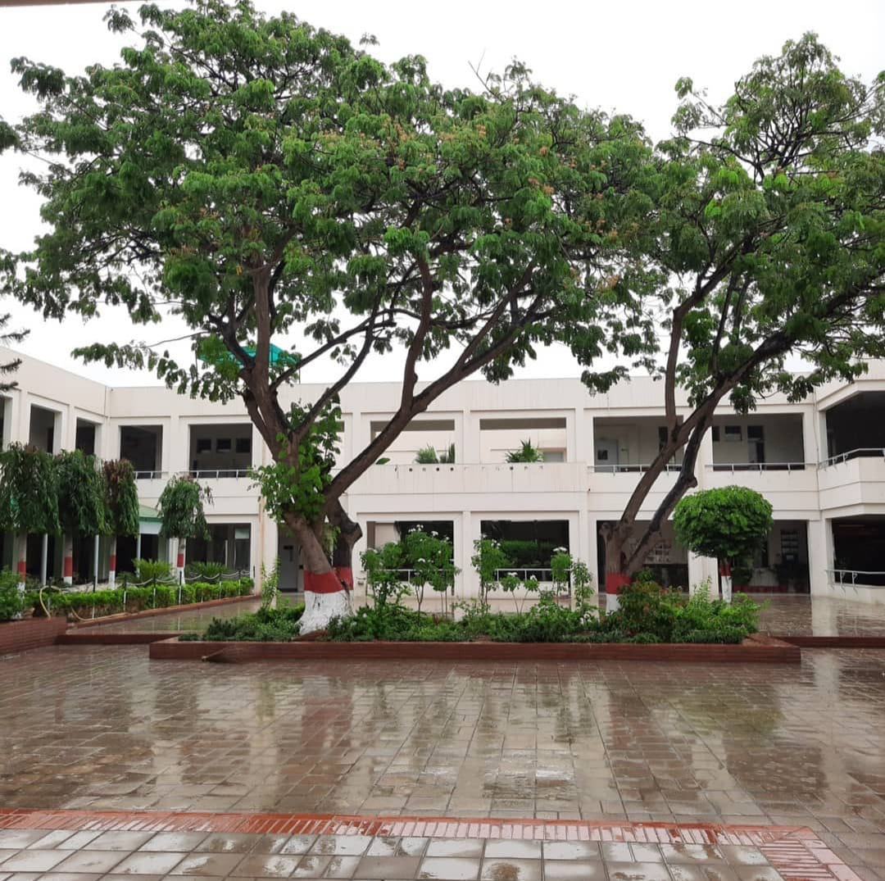
PECHS Girls’ School
Aga Khan Higher Secondary School

Slide 6
Likes
Few of my favorite past times is to read books, listen to music and watch animation and movies.
I prefer to write as an emotional outlet or go for a run.
When it comes to sports, I like to play badminton.
In terms of food, I mostly like Asian and pan-Asian cuisine or fast food.
The next slides contain snippets from my favorite books and series.

Slide 7
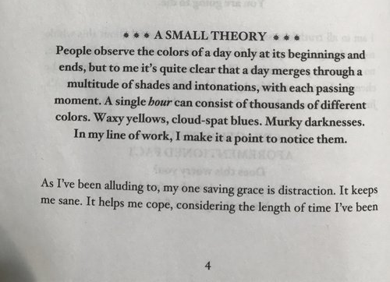
If you have a sister and she dies, do you stop saying you have one? Or are you always a sister, even when the other half of the equation is gone?
Sisters keeper – Jodi Picoult
Vanity is a factor , but it is more a question of control. It is easier to trick others into perceiving you as beautiful if you can convince yourself you're beautiful. But mirrors have and uncanny way of telling the truth.
The lunar chronicles, Cinder – Marissa Meyer
The Book Thief – Markus Zusak

Slide 8

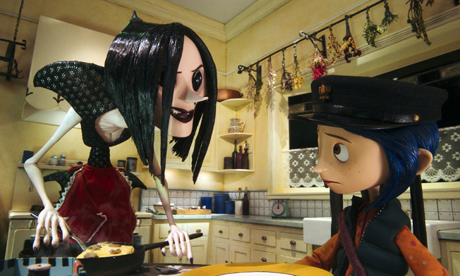
My favorite scenes from movies
https://youtu.be/skkzfkUK1jg - Coraline
https://youtu.be/E5J6Vmcr1j4 - Your Name
Your Name
Coraline

Slide 9
Skills
Public speaking
Content writing
Teaching
Communicating

Slide 10
Achievements
Took part in multiple debates and Panel discussion.
Led welfare projects such as clean-up drives.
Organized summer camp for underprivileged kids.

Slide 11
ICA course
One of the current course I am enrolled in is ICA (Introduction to Computer Applications) and it has been a very helpful course. It has taught me excel, word, PowerPoint, GIT and probably everything useful computer application.
After this course, I have a better understanding about how to use my computer easily and efficiently and how to keep my digital work more precise and presentable. It was a very helpful course.

Slide 12
Future goals
A degree in MBA
Help people
Help myself
Work for the betterment of society

Slide 13
Thankyou

